Slide 1
HydroDesktop – An Open Source Tool for Hydrologic data visualization, modeling and Analysis
Jiri Kadlec, Daniel P. Ames, Yang Cao
Biology Seminar Guest Lecture
Idaho Falls, ID

Slide 2
Outline of this Lecture
ISU Geospatial Software Lab
What IS GIS?
Hot Topics in GIS
MapWindow
HydroDesktop

Slide 3
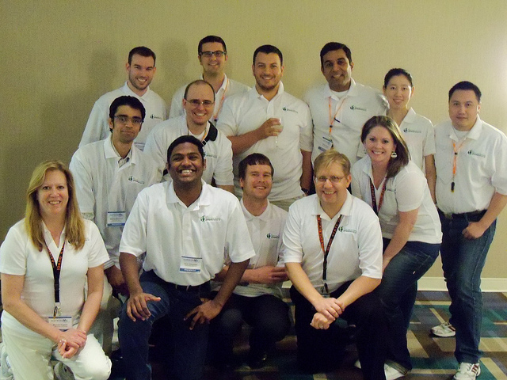
ISU Geospatial Software Lab
http://gsl.geology.isu.edu/
Main Goals:
development and application of open source geospatial software tools to address problems related to:
hydrology, climate variability, and energy production and transmission

Slide 4
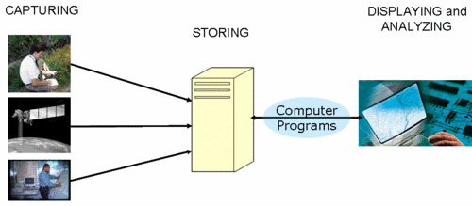
What is a Geographic Information System (GIS)?
System (People, software, hardware) for capturing, storing and analyzing geographically referenced data
Remote Sensing
Cartography
Statistical Analysis
Database Technology

Slide 5
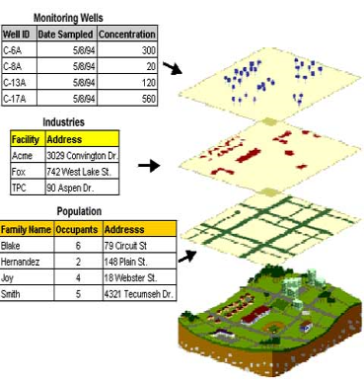
Applications of GIS
Business
Ecology
Habitat change
Migration patterns
Invasive species
Transportation
Hydrology
soil, water, atmosphere interaction

Slide 6
Components of Information System
Data
Surveys (GPS)
Aerial Photography
Satellite Images
Soil Samples ..
Software
Show map
View and edit attributes
Change Projection
Interpolation

Slide 7
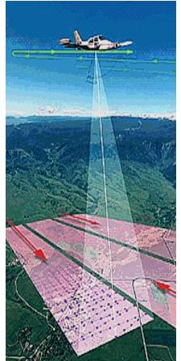
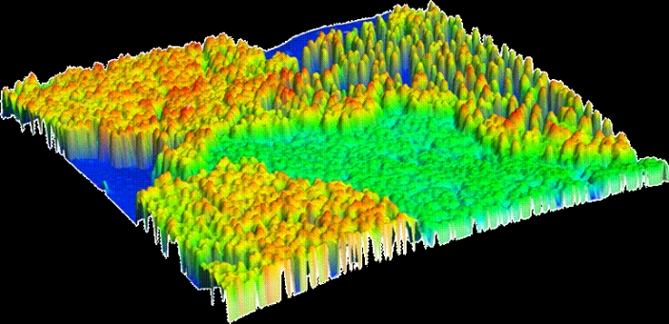
Research Focus in GIS
LiDAR (Light Detection and Ranging)
LiDAR – Based 3D vegetation data (lidarbasemaps.org)

Slide 8
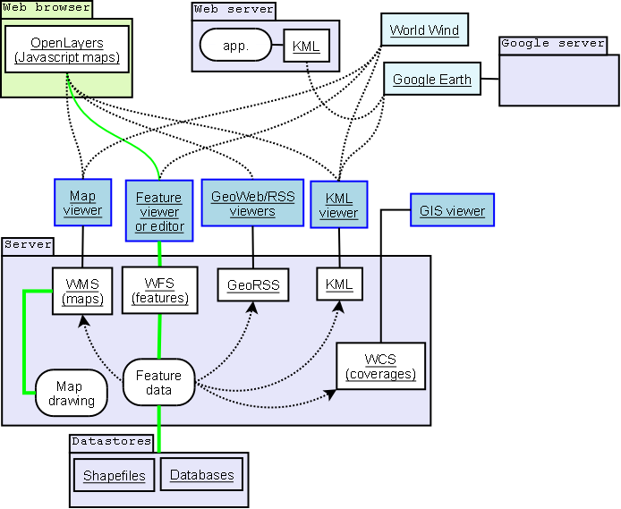
Web Services and Standards

Slide 9
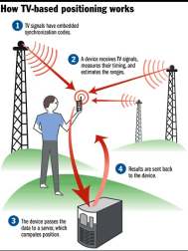
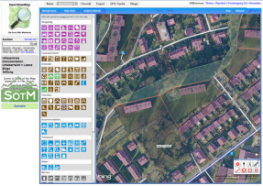
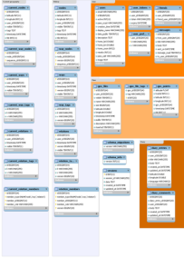

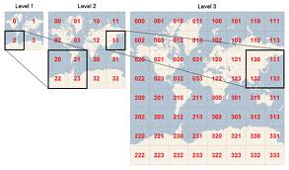
Collaboration to provide free Data - OpenStreetMap
Editor Software
Similar Philosophy to Wikipedia
Map Tiles (cached)

Slide 10
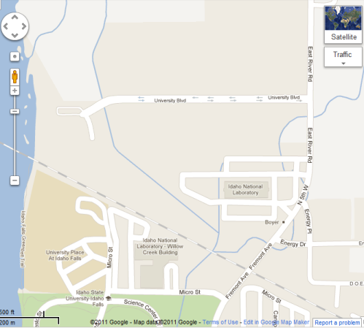
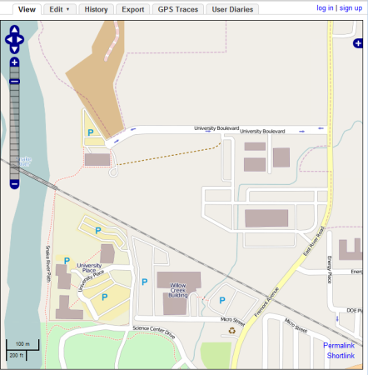
OpenStreetMap Example – Idaho Falls
Farmyard
Paths
Recycling
Google Map
OpenStreetMap

Slide 11



Our Software Products
Go to: www.mapwindow.org
These software tools
Are Free and Open Source

Slide 12
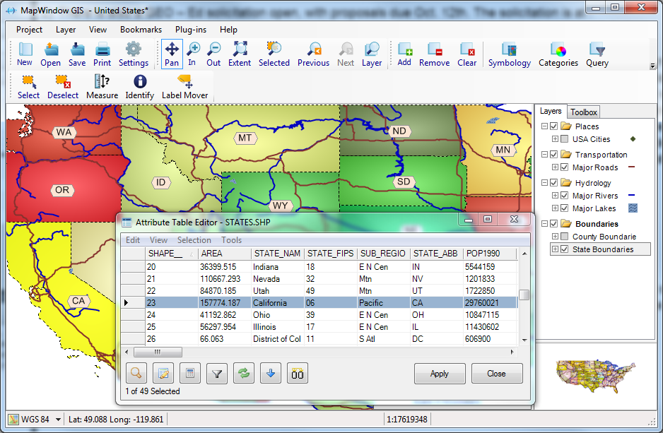
MapWindow 4.8

Slide 13
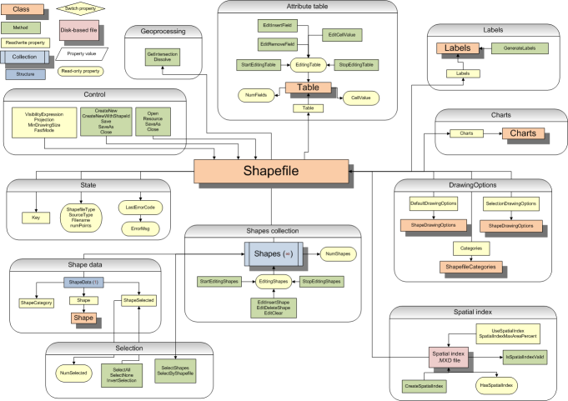
MapWinGIS and DotSpatial Components For programming Custom GIS Applications

Slide 14
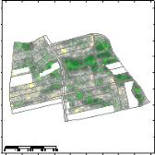
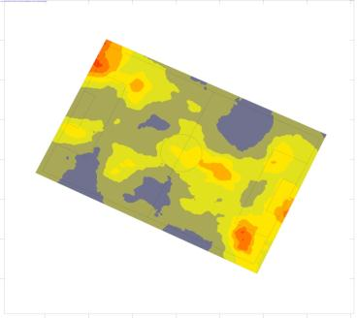
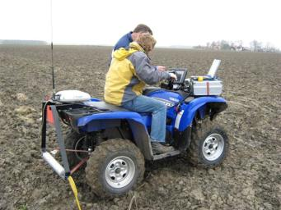
Custom application: Automated soil mapping using gamma-ray sensors
MapWindow GIS is used to create digital soil maps from raw sensor data
The Soil Company, Netherlands
http://www.soilcompany.nl

Slide 15
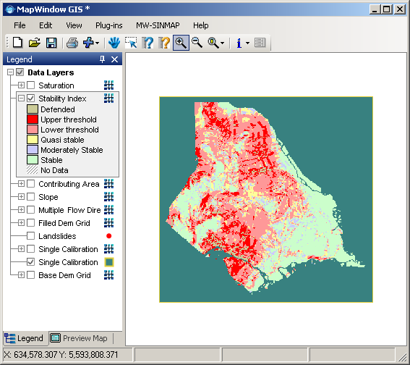
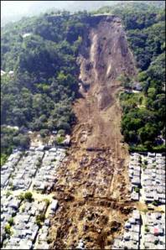
Terrain Stability hazard mapping (SINMAP)
Creates a map of landslide hazard
MapWinGIS components are used for DEM data processing
Instituto di Idraulica Agraria di Milano, Italy
http://users.unimi.it/idra/index.php/download/software/46-software/94-mw-sinmap-v10

Slide 16
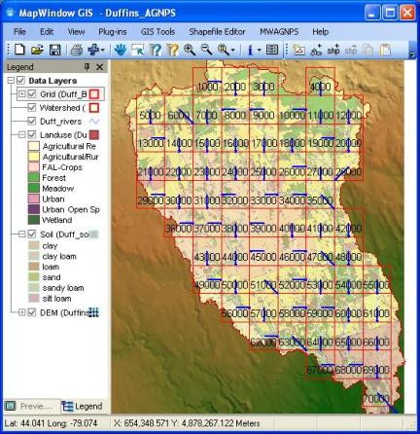
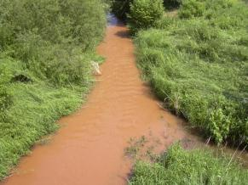
Water Quality Modeling
AGNPS model predicts the effects of agriculture on water quality
MapWinGIS components are used to prepare model input data and display model results
WaterBase
http://www.waterbase.org

Slide 17
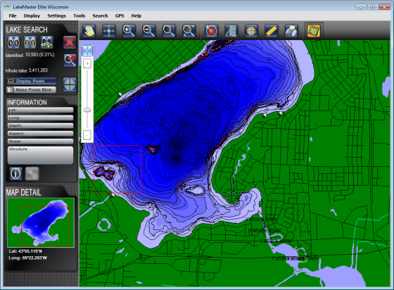
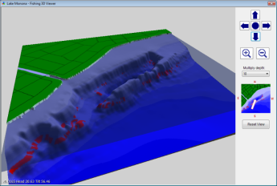
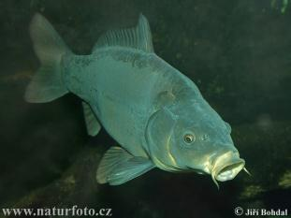
Fishing Map
3D – view of lake bottom
Shows parts of lake preferred by the fish
Strategic Fishing Systems
http://www.lakemap.com

Slide 18
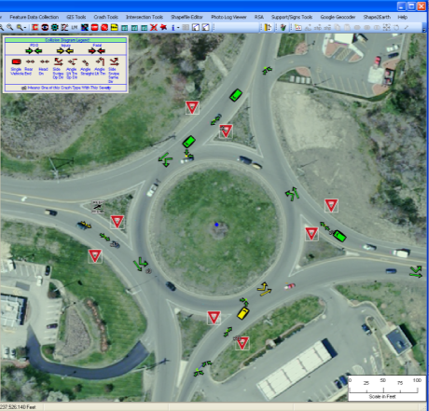
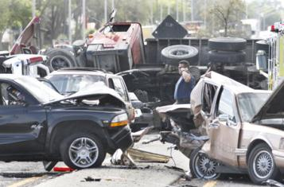
Road Safety Analysis
MapWinGIS component is used to display and analyze collisions at road intersections
Utah LTAP – Safety Software Suite
http://www.utahltap.org/safetysoftwaresuite/

Slide 19
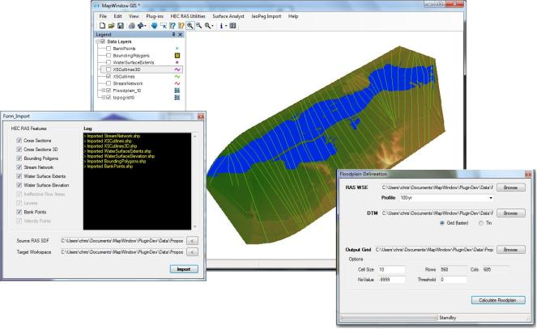
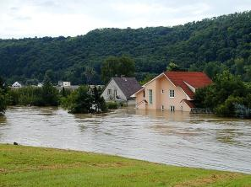
Floodplain mapping
HEC-RAS simulation model is used to calculate flooded areas
MapWindow GIS is used to prepare model inputs and display results
Environmental Observations and Research Group
http://www.envorg.com

Slide 20
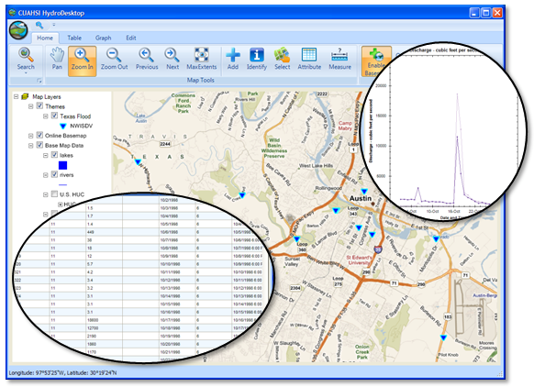
Integrating Spatial and Time information in GIS: HydroDesktop
HydroDesktop is GIS tool for hydrologic and climate data discovery, visualization and analysis
What type of data?
Climate (precipitation, temperature)
Hydrology (stream discharge)
Water Quality (nitrogen, phosphorus)
Hydrobiology (indicator organisms)
www.hydrodesktop.org

Slide 21
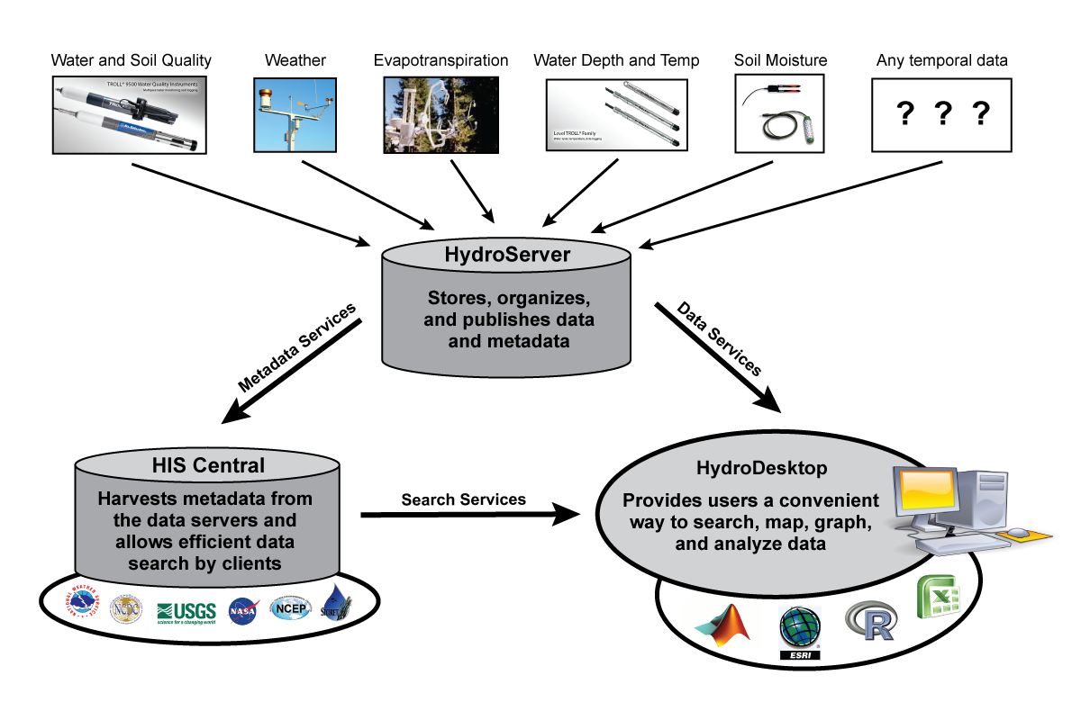
CUAHSI Hydrologic Information System
CUAHSI = Consortium of Universities for Advancement of Hydrologic Science
Source: Ames et al, 2011

Slide 22
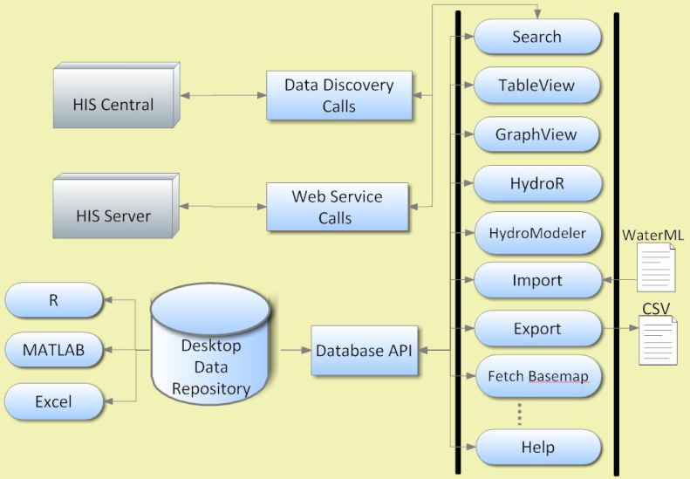
Software Design of HydroDesktop
Source: Yang Cao, 2011

Slide 23
Features of HydroDesktop
Map
GIS Tools
Data Search
Graph
Table
HydroR
HydroModeler
Watershed Delineation

Slide 24
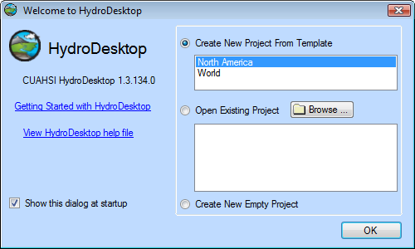
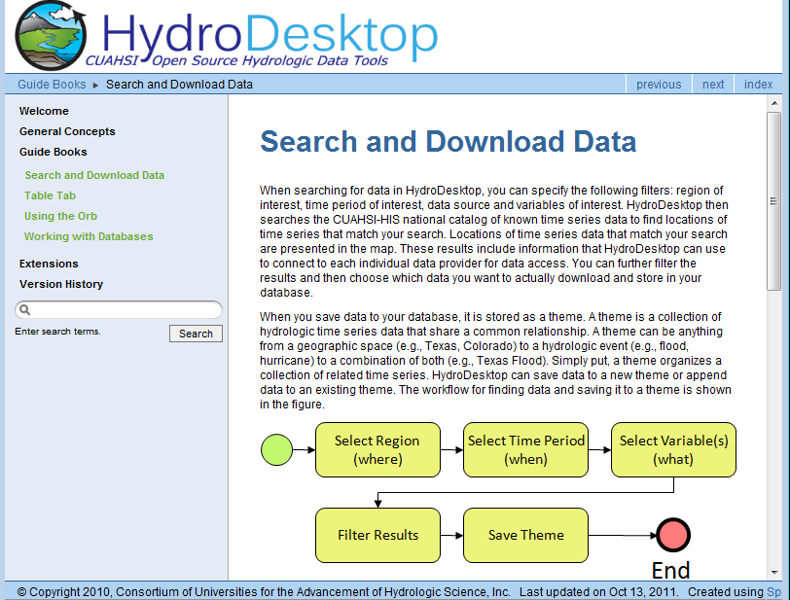
Start HydroDesktop

Slide 25
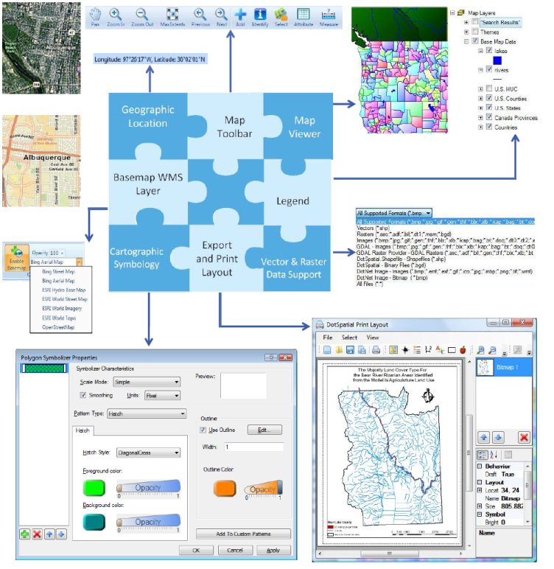
HydroDesktop GIS Map Functions

Slide 26
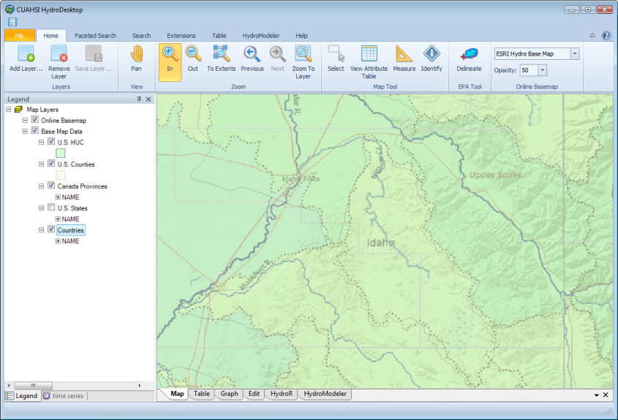
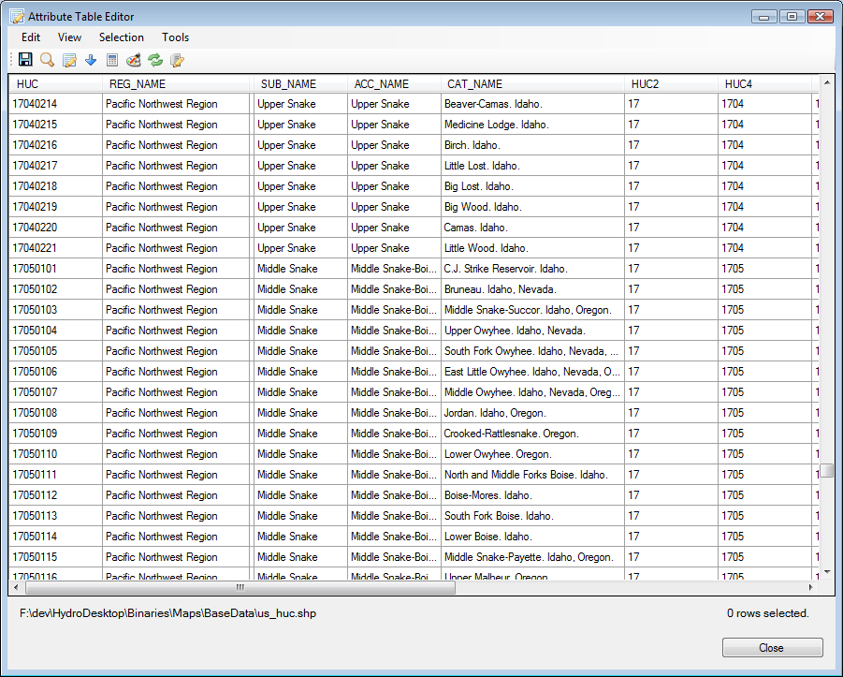
Map – Hydro Base Map and table

Slide 27
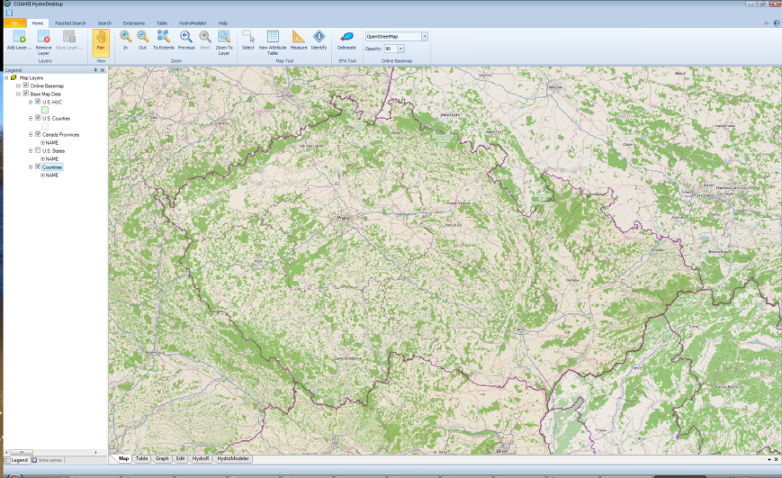
Map - OpenStreetMap

Slide 28
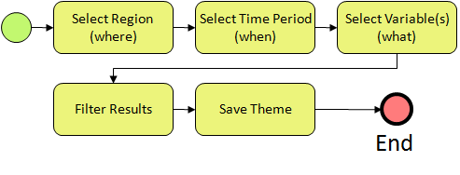
Searching for data in HydroDesktop

Slide 29
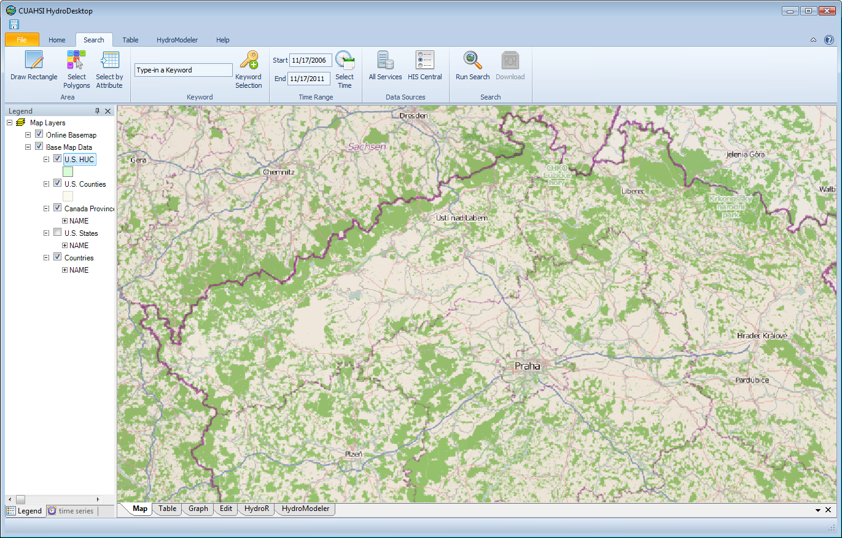
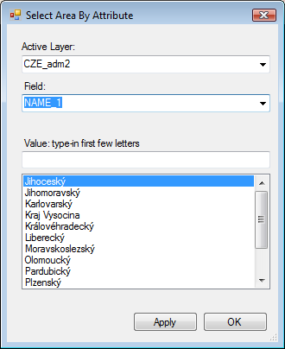
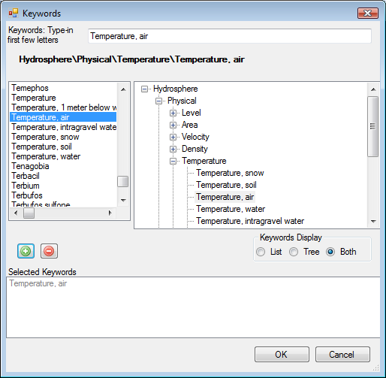
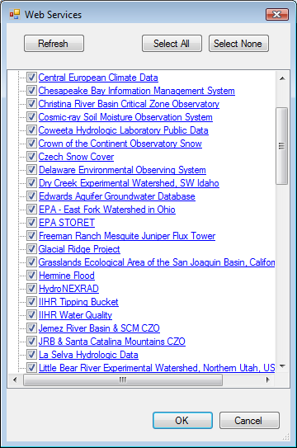
Search Toolbar

Slide 30
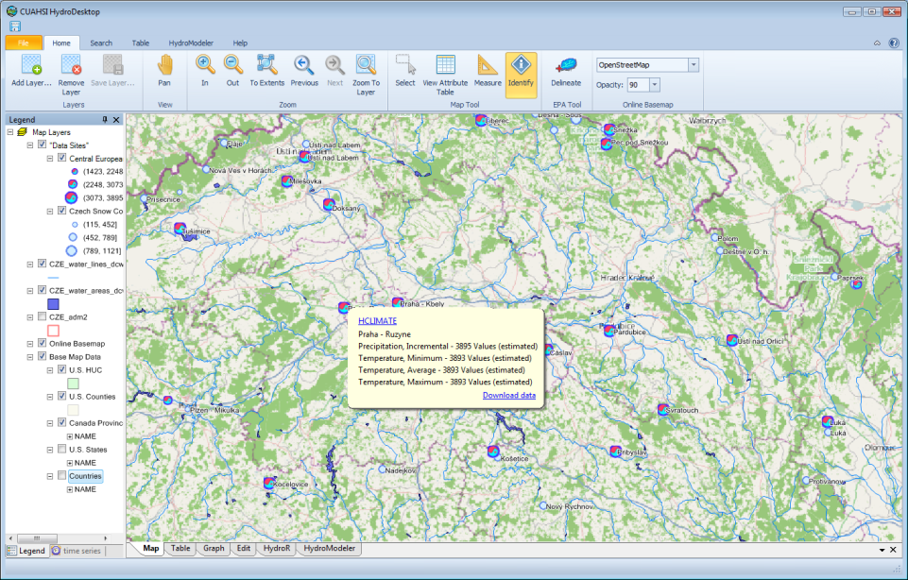
Display Search Results in Map
Mouse-over the site to show available variables

Slide 31
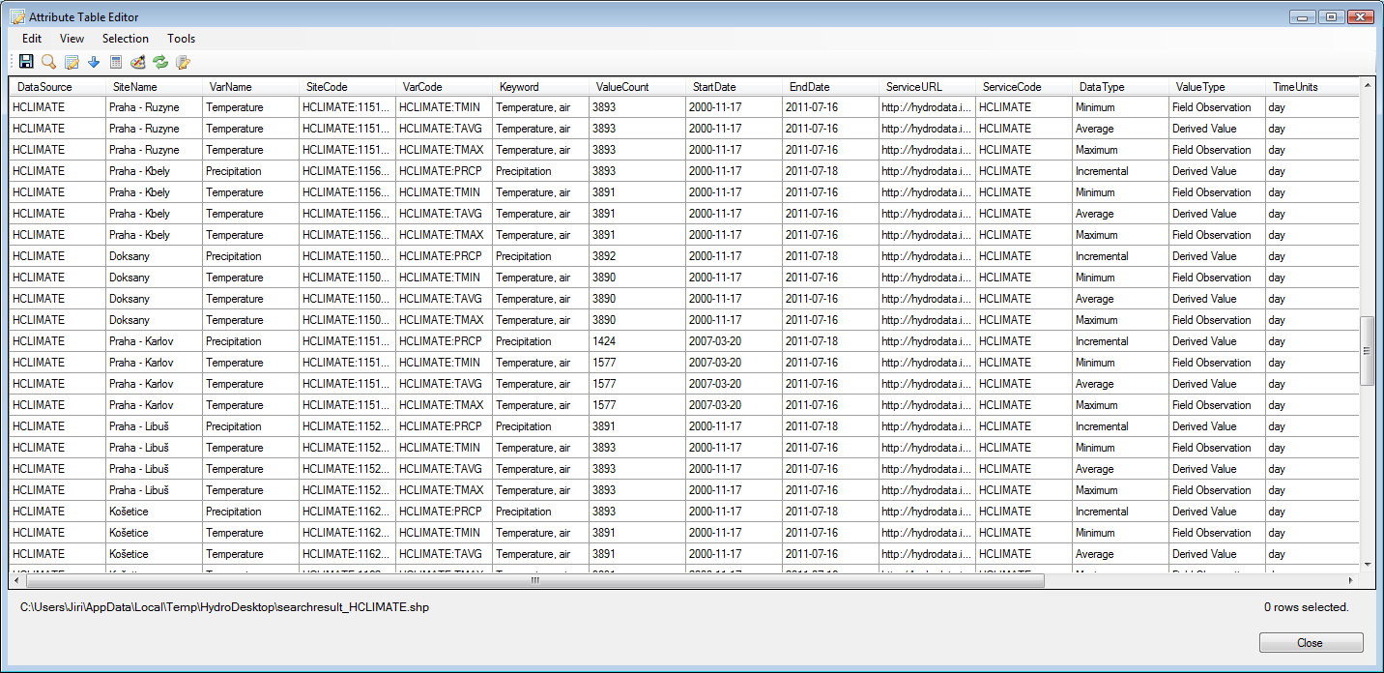
Display Search Results in Table

Slide 32
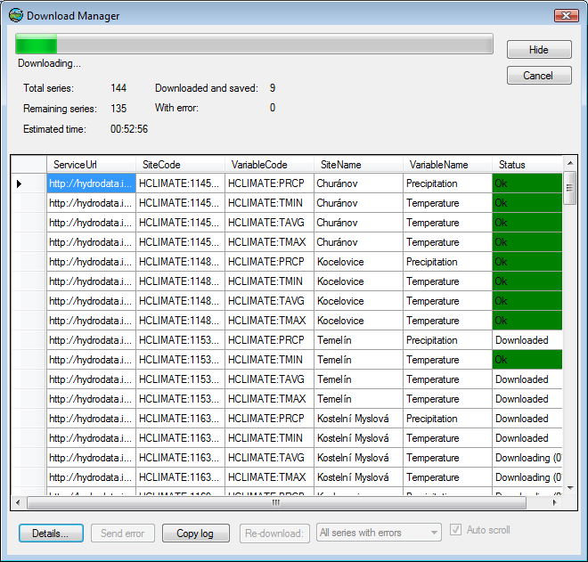
Downloading Time Series Data

Slide 33
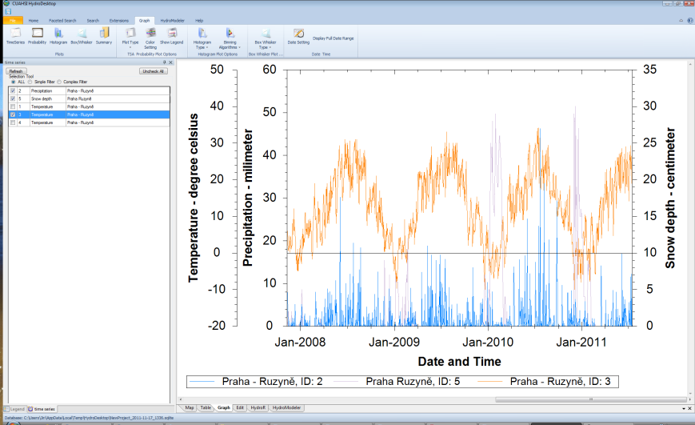
Graph: Temperature, Precipitation

Slide 34
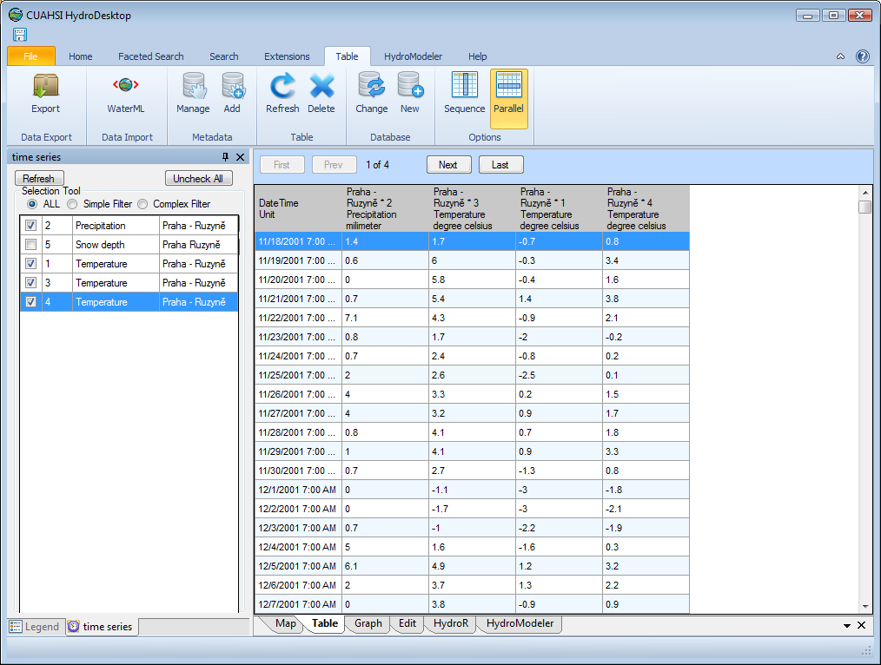
Table View

Slide 35
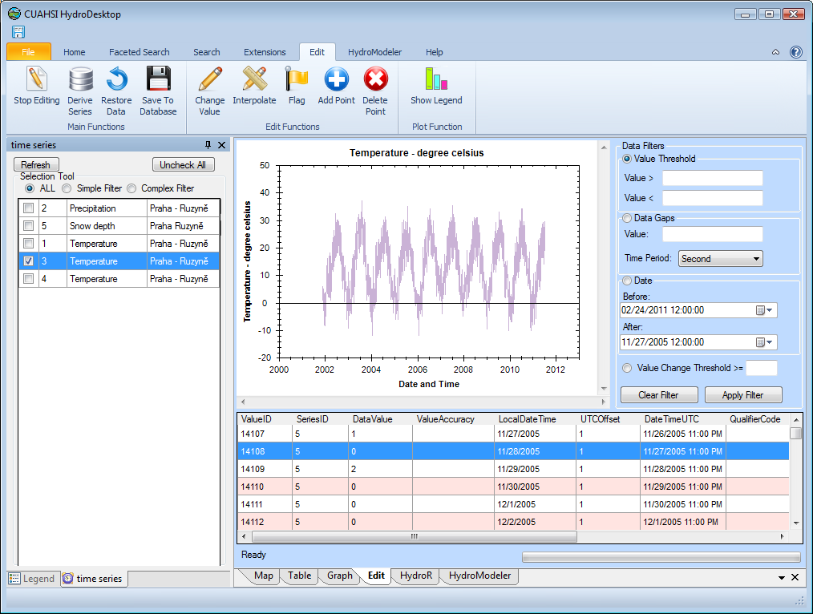
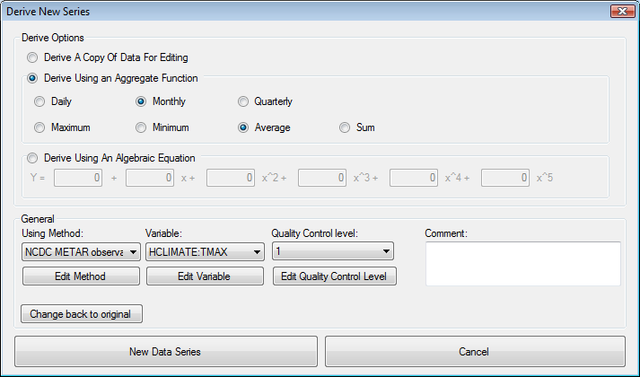
Data Editing View

Slide 36
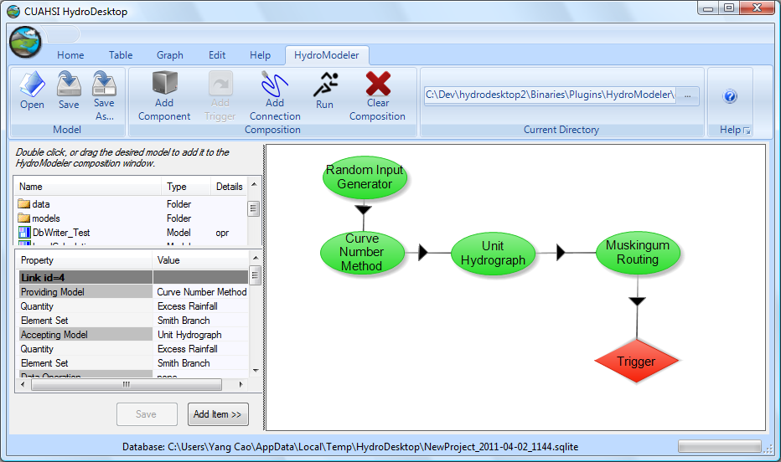


HydroModeler
Build your own Hydrological simulation model (infiltration, soil water storage, flow routing)

Slide 37


Example of analysis in HydroDesktop – Drought Analysis
Drought = extended period with deficiency in water supply
Meteorological, Hydrological, Agricultural Drought
Russia Drought and wildfires, 2010
USA Texas Drought, 2011

Slide 38

We use the HydroR extension

Slide 39
Meteorological Drought Index – Mass Curve Method
Precip. (mm) | Precipitation >= (mm) | 0 | 0,1 | 0,3 | 0,7 | 1,5 | 3,1 | 6,3 | 12,7 | 25,5 | 51,1 | ...
 | Precipitation < (mm) | 0 | 0,2 | 0,6 | 1,4 | 3 | 6,2 | 12,6 | 25,4 | 51 | 102,2 | ...
 | Interval width | 0 | 0,2 | 0,4 | 0,8 | 1,6 | 3,2 | 6,4 | 12,8 | 25,6 | 51,2 | ...
Z | transformed variable | -1 | 0 | 1 | 2 | 3 | 4 | 5 | 6 | 7 | 8 | ...
Weight variable for precipitation
2. Mass curve
(cumulative sum)
3. Include air temperature factor
S_{j} = (X_{j} – Y_{j}) ∙ ∑T ∙ 10⁻³

Slide 40

Meteorological Drought – Result graphs in HydroR
Drought Periods (times of year) at Praha – Ruzyne station

Slide 41

HydroDesktop User Group and Website

Slide 42

HydroDesktop Website and User Group

Slide 43


Thank you for your attention !
www.mapwindow.org
www.hydrodesktop.org

